Slide 1

C++ & DSA PLACEMENT COURSE
Khaiser Khanam

Slide 2

DATA STRUCTURES AND ALGORITHMS (DSA) INTRODUCTION

Slide 3

Todays Lecture
DATA STRUCTURE AUR ALGORITHM HOTA KYAA HAI
WHY DATA STRUCTURE MATTERS?
TYPES OF DATA STRUCTURES
TYPES OF ALGORITHMS
WHY DSA IS IMPORTANT?
REAL LIFE DSA EXAMPLES
REAL-WORLD APPLICATIONS OF DSA
INTERVIEW MEIN DSA KA ROLE
WHY TO LEARN DSA?
AND MOST IMPORTANT MUST-KNOW CONCEPTS BEFORE LEARNING ADVANCED DSA

Slide 4
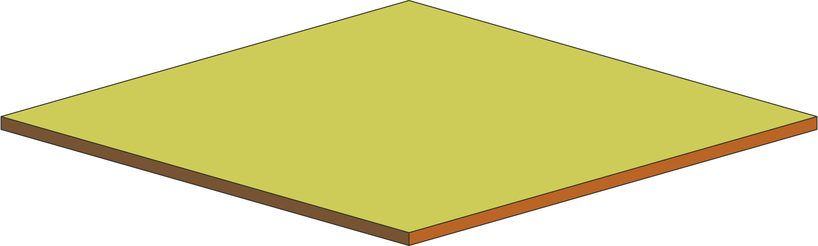
Data Structures and Algorithms
D
Data
S
Structures
Programming
A
Algorithms
Base

Slide 5



Green Shirt
Medium Size
Under ₹500
10,000 Products

Slide 6

Arrangement 1
Sab kuch randomly pada ho
Green Shirt
Medium Size
Under ₹500
Arrangement 2
Products ache se categories mein arranged ho (jaise Shirts > Color > Size > Price)

Slide 7



Arrangement 1
Sab kuch randomly pada ho
Arrangement 2
Products ache se categories mein arranged ho (jaise Shirts > Color > Size > Price)

Slide 8
Data Structures and Algorithms
Data Structure: Mall ka arrangement.
Algorithm: Aapki searching strategy.
Data Structure: Data ko arrange karne ka tareeka hota hai
Algorithm: Us data se kaam karne ka process

Slide 9

Example
Randomly Arranged Name
Khanam
1 to 500 Names
Sorted Way Arranged
a,b,c,.....khanam, l,m,n...z
500 Students
Few steps

Slide 10
Data structure ek smart tarika hai data ko rakhne ka.
Jisse hum fast searching, inserting, deleting jaise kaam efficiently kar sakte hain.
Data Structure ki madad se hum data ko samajhdari se rakhte hain, taaki us par operations fast ho jaayein.

Slide 11
Why Data Structure Matters?
Fast searching
Fast inserting/deleting
Efficient memory usage
Solves real-world problems easily
Bina data structure ke code likhna = Room mein saman phek dena bina almerah ke.
Data structure ke saath code likhna =Saari cheezein properly organized karna inside almerah.

Slide 12
Types of Data Structures
Linear Data Structures
Non-Linear Data Structures
Linear Data Structures
Non-Linear Data Structures
Array
Linked List
Stack (LIFO – Last In First Out)
Queue (FIFO – First In First Out)
Deque (Double-Ended Queue)
Tree
Graph
Hash Tables

Slide 13

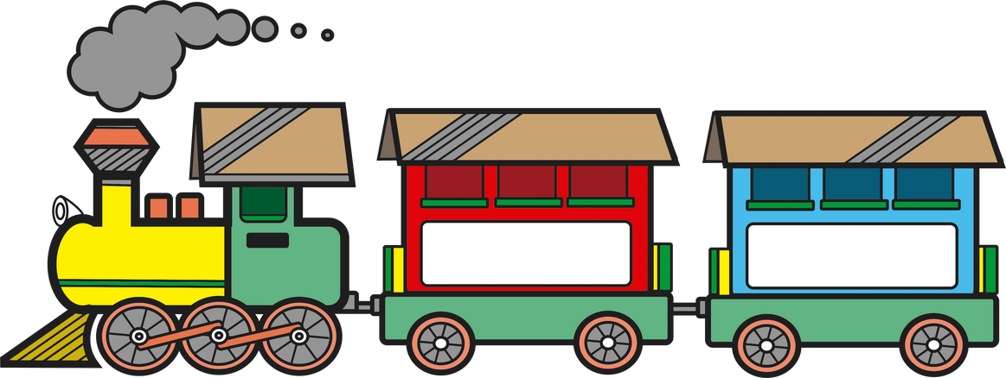
Linear Data Structures
Data is arranged in a sequence or line (ek ke baad ek).
Ye woh structures hote hain jahan data ko ek line mein store kiya jaata hai — jaise ek queue ya train ke bogie

Slide 14

Linear Data Structures
Arrays
o Fixed size, index-based data storage.
o Books straight line mein arranged.
o Position fixed hoti hai (index).

Slide 15

Linear Data Structures
Linked List
Data nodes connected via pointers.
Treasure Map
Har node ek pointer rakhta hai next node ka — like a chain
Types
i. Singly Linked List
ii. Doubly Linked List
iii. Circular Linked List

Slide 16





Linear Data Structures
Stack
5
(LIFO – Last In First Out)
Example: Tiffin Box
Last wala box sabse pehle niklega
4
3
2
1

Slide 17


Linear Data Structures
Queue
(FIFO – First In First Out)
Example: Cinema Line
Pehle jo aaya, woh pehle niklega

Slide 18



Linear Data Structures
Deque
(Double-Ended Queue)
Insertion/Deletion from both ends.
Example: School Bus
Front se students chadh bhi sakte hain, utar bhi sakte hain
Back se bhi chadhna-utarna allowed hota hai

Slide 19

Non-Linear Data Structures
Data is not stored in a sequence, but in a hierarchical or interconnected form.

Slide 20

Non-Linear Data Structures
Tree
Hierarchical structure with parent-child relation.
Example: Family Tree
Ek root node se multiple branches nikalti hain.
Types
i. Binary Tree
ii. Binary Search Tree (BST)
iii. AVL Tree
iv. Heap
v. B-Trees

Slide 21

Non-Linear Data Structures
Graph
Data stored as nodes (vertices) connected with edges.
Example: Google Map
Multiple cities (nodes) aur unke beech ke connections (edges).
Types
i. Directed / Undirected
ii. Weighted / Unweighted
iii. Cyclic / Acyclic

Slide 22


Non-Linear Data Structures
Hash Tables
It is a key-value pair data structure.
Example: Dictionary
Key - apple
Value - a fruit

Slide 23


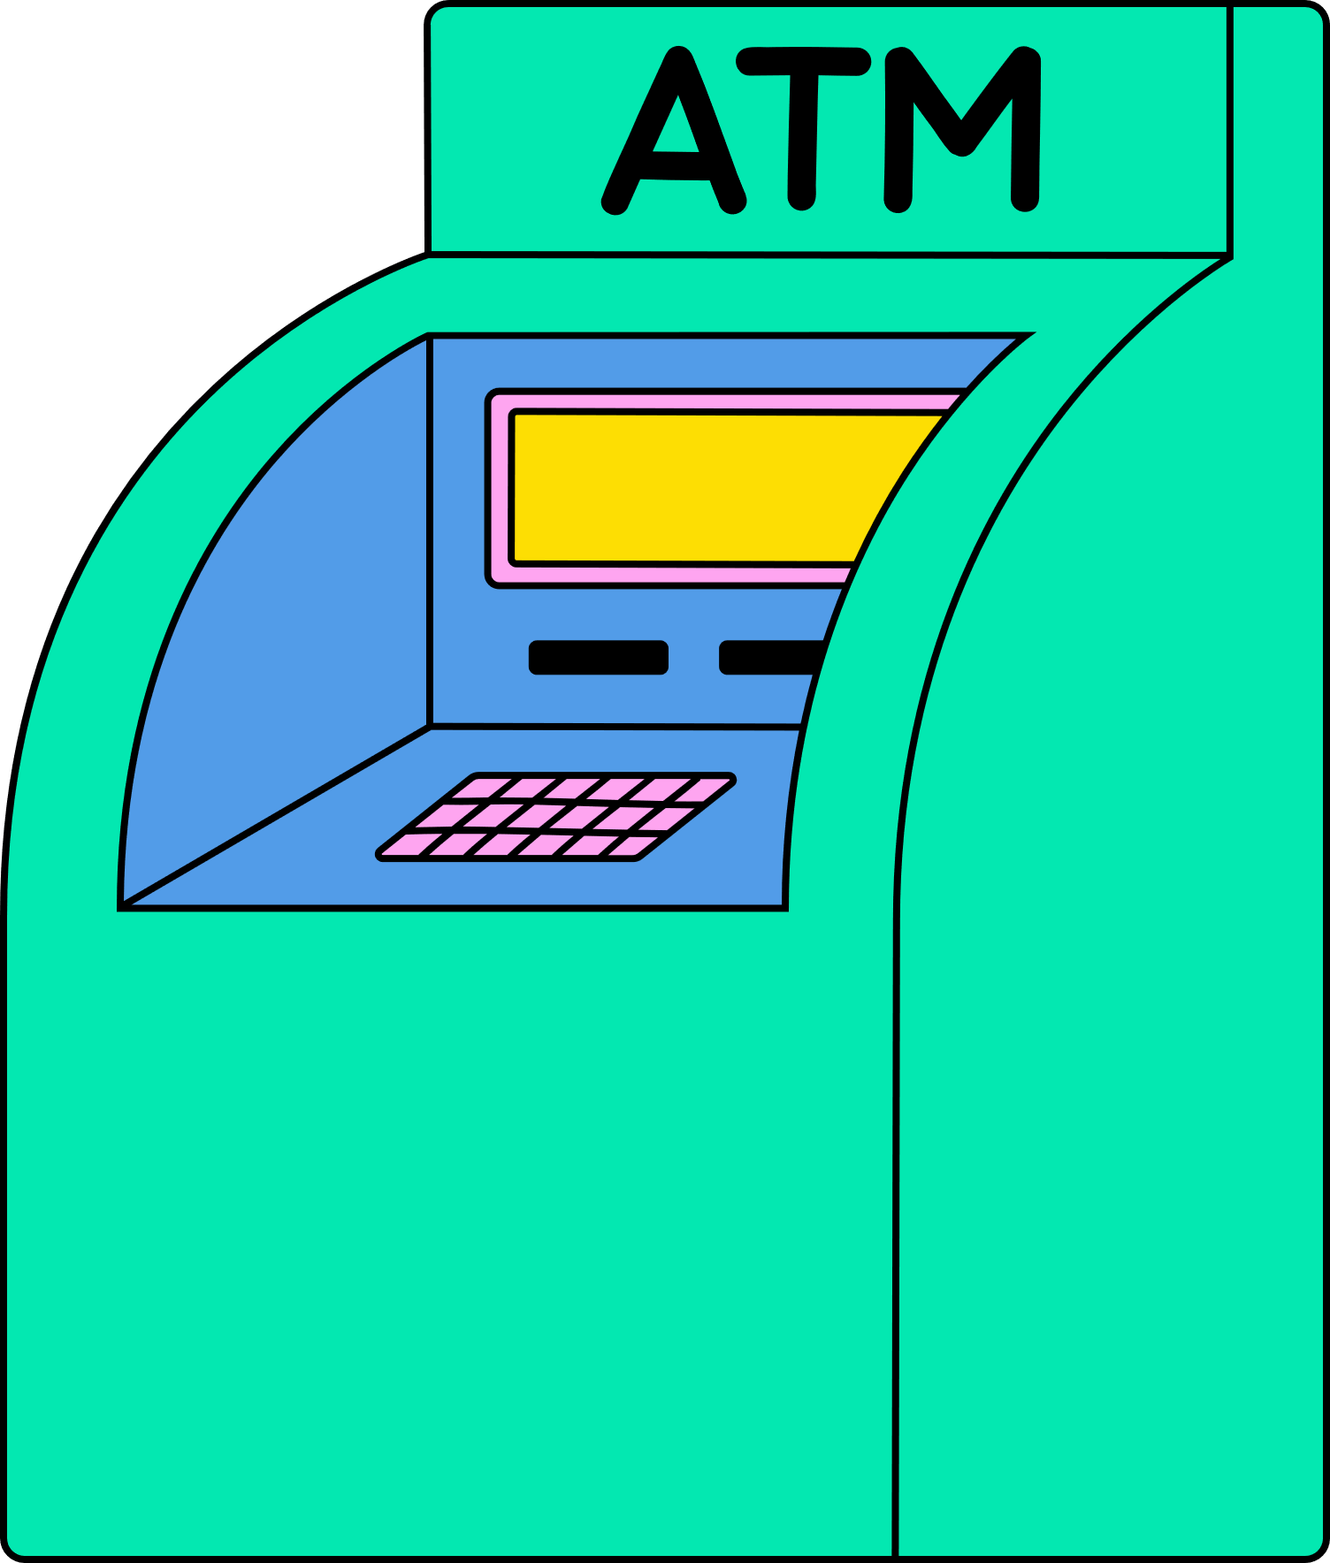
What is Algorithm
Algorithm ek set of rules ya steps hota hai jo kisi problem ko solve karne ke liye follow kiya jaata hai.
Real Life Examples
Cooking Recipe = Algorithm
2. ATM Machine
3. Google Search

Slide 24
Types of Algorithms
1. Sorting
2.Searching
3.Greedy
4.Divide & Conquer
5.Dynamic Programming
6. Backtracking
7.Graph Algorithms

Slide 25
Types of Algorithms
Sorting
Data ko sahi order mein lagana — chhota se bada ya A-Z ya 1-100 tak
Roll number list ko ascending order mein lagao
Examples
Bubble Sort, Quick Sort, Merge Sort

Slide 26

Types of Algorithms
Searching
Data ke andar se kisi ek value ko dhoondhna
Class mein Khanam ko dhoondhna
Examples
Linear Search, Binary Search

Slide 27

Types of Algorithms
Greedy
Har step pe jo best lagta hai wahi choose karo, bina future ka sochhe
Mumma ne bola sabse sasta mango le lo har dukaan se
Examples
Coin Change, Activity Selection

Slide 28

Types of Algorithms
Divide & Conquer
Problem ko chhote-chhote parts mein tod ke solve karna, phir jodna
Badi problem ko parts mein baant ke solve karo
Examples
Merge Sort, Binary Search

Slide 29

Types of Algorithms
Dynamic Programming
Same sub-problems ka answer store karke reuse karna, taaki time bache
Pehle wale sawal ka answer yaad rakhna — dobara calculate na karo
Examples
Fibonacci, Knapsack, Longest Common Subsequence

Slide 30

Types of Algorithms
Backtracking
Try karo → Agar fail ho jao to wapis jaake dusra rasta try karo
Maze mein ghoom rahe ho, wrong turn liya? Wapis jaake dusra rasta try karo
Examples
N-Queens, Sudoku Solver

Slide 31
Types of Algorithms
Graph Algorithms
Aise problems jahan connections ya paths important ho (nodes and edges)
Google Maps — shortest route ya sabse kam traffic wala path nikalna
Examples
BFS, DFS, Dijkstra, Kruskal

Slide 32

Data Structures + Algorithms = 💥
DSA = Data ko smartly store karna + Problems ko efficiently solve karna.
DSA ek team hai – Dono kaam tabhi karte hain jab saath mein ho

Slide 33
Why DSA is Important?
Problem Solving Skills badhti hai
Code fast & optimized hota hai
Big Tech Interviews mein 90% sawaal DSA ke hote hain
Real-world problems ka best solution milta hai

Slide 34
Real-World Applications of DSA
🌐 Web Search Engines (Google, Bing, etc.)
🗃️ Databases (MySQL, MongoDB, etc.)
🌐 Networking (Internet, Routers, Packets)
💽 Operating Systems (Windows, Linux, etc.)
🤖 Artificial Intelligence & Machine Learning
🔐 Cybersecurity (Encryption, Decryption)
🛒 E-Commerce Platforms (Amazon, Flipkart, etc.)

Slide 35
Interview Mein DSA ka Role
DSA is the language of problem solving.
✅ 90% tech interviews mein DSA based questions hote hain
Google: Trees, Graphs, DP
Amazon: Arrays, Hashmaps, Sliding Window
Microsoft: Backtracking, Heaps
Startups: Real-life use-case-based DSA

Slide 36
Why Learn DSA?
Problem-Solving Skills
Technical Interviews
Efficient Coding
Foundation for Advanced Topics

Slide 37
Must-Know Concepts Before Learning Advanced DSA
1.Variables & Data Types
2.Conditional Statements
3.Loops (for, while)
4.Functions & Recursion
5.Arrays and Strings basics
6.Pointer (for C++ learners)

Slide 38
DSA ek skill nahi, ek mindset hai
Sochne ka tareeka hota hai — “Kaise sabse accha aur fast solution laayein?”

